Slide 1

Share your travel experiences through guides and photos
Afonso Ferreira | Carolina Rodrigues | Martim Caiado | Rodrigo Lebre

Slide 2
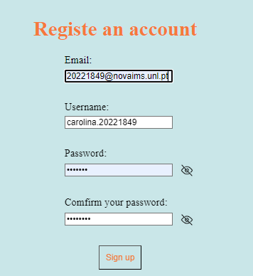
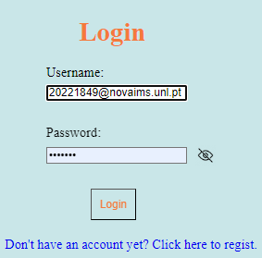
Create an account
Sign up with your email
Choose a unique username
Set a profile picture
Edit anytime you want

Slide 3
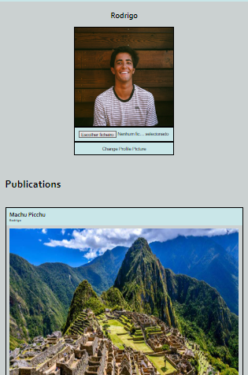
Upload and share trip guides
Add your location so other users can see.
Add captions to describe your travel experiences.
Give tips to fellow travellers.
Take advantage of real, authentic perspectives from the most experienced travellers.

Slide 4
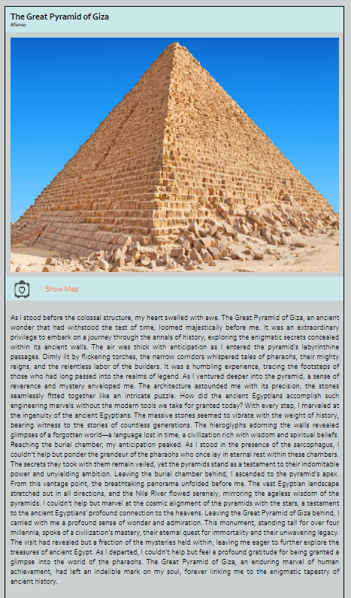
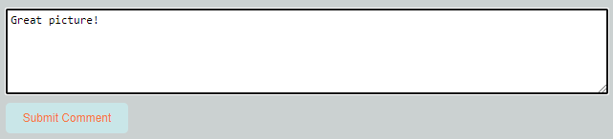
Explore other users' photos
View photos from users all around the world.
Like and comment on other users' photos.
Learn about the places other users have been to.
Share your experiences with a global community of adventurers.

Slide 5
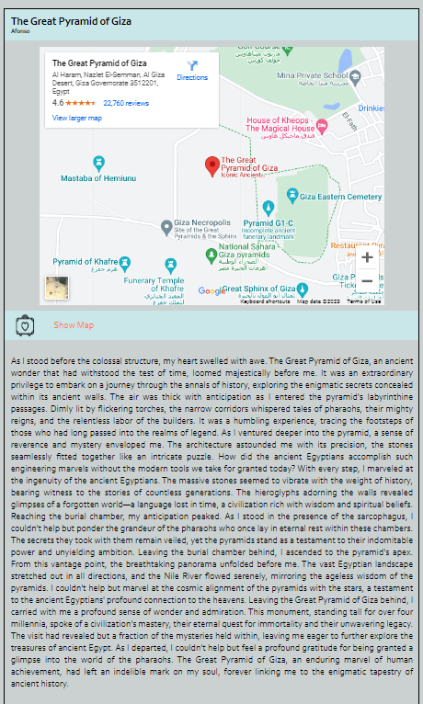
View photos on a map
See all your own photos plotted on a map.
View photos from other users on a world map.

